Slide 1
ME759 High Performance Computing for Applications in Engineering [Spring 2020]
Lecture 27
04/01/2020
Dan Negrut, 2020 ME759 UW-Madison

Slide 2
Things to do, for Canvas live-session
Dan: start the Canvas recording
Everybody else:
Please mute your microphone
Please ask questions (limit: two per person per lecture; after that, post on Piazza)
When you ask questions, first unmute your mic

Slide 3
The deep thinking of the day
Just like the folks who for the entire semester have been watching me @ home at 1.5X speed while enjoying the favorite brew, now I can do the same: reaching for a cold one while lecturing ME759 over Canvas…
Does that cold one have any collateral effect? Perhaps my accent improves???

Slide 4
Quote of the day
“There is nothing new in the world except the history you do not know.”
-- Harry S. Truman, 33rd president of the United States [1884 –1972]

Slide 5
Before we get going…
Last time:
Optimization aspects, wrapped up
ILP & vectorization aspects
Distributed memory parallel computing via MPI
Discussion of underlying hardware
TOP500
Message Passing Interface (MPI): warmup
Today:
MPI: point-to-point communication
Other tidbits:
ME759 Exam: April 15, at 7:15 PM, in Canvas
Review: Tu, April 14, at 7:00 PM, in Canvas
Final Project Proposal: Dan to provide feedback this week
Last ME759 lecture is on Friday
Assignment is due on Friday
x = x OP (d[i] OP d[i+1]);
d₀
d₁
*
d₂
d₃
1
*
d₄
d₅
*
*
d₆
d₇
*
*
*
*

Slide 6
[new topic] HPC with the Message Passing Interface (MPI): Outline
Introduction to message passing and MPI
Point-to-Point Communication
Collective Communication
HPC w/ MPI: Closing Remarks

Slide 7
MPI: High-level overview
N instances of the same program are launched for execution independently as N distinct processes
Flynn Taxonomy classification: MIMD
MPI & Distributed Memory: enables a MIMD computing mechanism
Multiple Instruction and Multiple Data
Another way to look at it: Single Program Multiple Data (SPMD)

Slide 8
Parallel Computing w/ MPI: One way to look at it
CUDA: a small snippet of code (the “kernel”) run by all threads spawned via your exec. config.
OpenMP: all threads execute an omp parallel region; name of the game is work sharing
MPI: the *entire* code is executed in parallel by all processes

Slide 9
A First MPI Program
#include "mpi.h"
#include <iostream>
int main(int argc, char **argv) {
int my_rank, n;
char hostname[128];
MPI_Init(&argc,&argv);
MPI_Comm_rank(MPI_COMM_WORLD, &my_rank);
MPI_Comm_size(MPI_COMM_WORLD, &n);
gethostname(hostname, 128);
if (my_rank == 0) { /* master */
printf("I am the master: %s\n", hostname);
}
else { /* worker */
printf("I am a worker: %s (rank=%d/%d)\n", hostname, my_rank, n-1);
}
MPI_Finalize();
return 0;
}
Has to be called first, and once only
Nothing special about rank=0.
Has to be called last, and once only
[A. Snavely]→

Slide 10
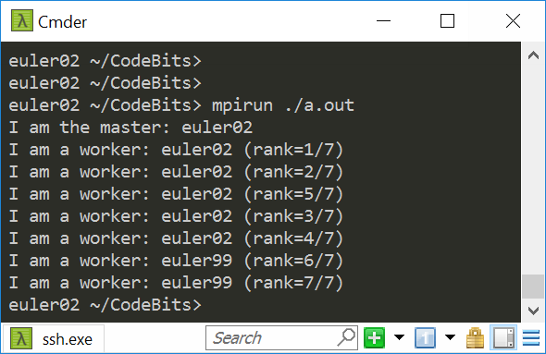
Program Output
I asked for 8 ranks
Got my 8 ranks spread out over two nodes: euler02 and euler99
Please use Slurm to run your jobs; instructions in the assignment. Colin can assist if you have questions

Slide 11
MPI: High-level Overview
Each MPI process, which runs most often on one core, executes the same executable at roughly the same time
Synchronization calls can be invoked (more later); useful to coordinate the execution of the MPI job
Unlike in CUDA, synchronization w/ MPI can be global

Slide 12
MPI: High-level Overview
What differentiates processes is their rank: processes with different ranks do different things (“branching based on the process rank”)
Very similar to GPU computing, where one thread did work based on its thread index
Very similar to OpenMP function omp_get_thread_num()

Slide 13
The Message-Passing Model
Each process has its own program counter *and* address space
Message passing enables communication among processes that have separate address spaces
Inter-process communication typically consists of
Synchronization, followed by…
… movement of data from one process’s address space to another process’s address space

Slide 14
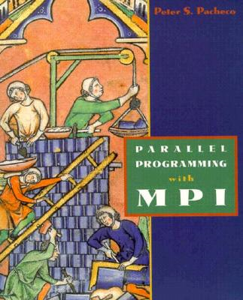
MPI: A Second Example Application
Example from Peter Pacheco’s book: “Parallel Programming with MPI”
/* greetings.c -- greetings program
*
* Send a message from all processes with rank != 0 to process 0.
* Process 0 prints the messages received.
*
* Input: none.
* Output: contents of messages received by process 0.
*
* See Chapter 3, pp. 41 & ff in PPMPI.
*/

Slide 15
MPI: A Second Example Application
#include "mpi.h"
#include <stdio.h>
#include <string.h>
int main(int argc, char* argv[]) {
int my_rank; /* rank of process */
int p; /* number of processes */
int source; /* rank of sender */
int dest; /* rank of receiver */
int tag = 0; /* tag for messages */
char message[100]; /* storage for message */
MPI_Status status; /* return status for receive */
MPI_Init(&argc, &argv); // Start up MPI
MPI_Comm_rank(MPI_COMM_WORLD, &my_rank); // Find out process rank
MPI_Comm_size(MPI_COMM_WORLD, &p); // Find out number of processes
if (my_rank != 0) {
/* Create message */
sprintf(message, "Greetings from process %d!", my_rank);
dest = 0;
/* Use strlen+1 so that '\0' gets transmitted */
MPI_Send(message, strlen(message)+1, MPI_CHAR, dest, tag, MPI_COMM_WORLD);
}
else { /* my_rank == 0 */
for (source = 1; source < p; source++) {
MPI_Recv(message, 100, MPI_CHAR, source, tag, MPI_COMM_WORLD, &status);
printf("%s\n", message);
}
}
MPI_Finalize(); // Shut down MPI
return 0;
} /* main */
Type of each sent item
Destination process rank
Identifier for this message
Buffer to be sent
Number of items to send

Slide 16
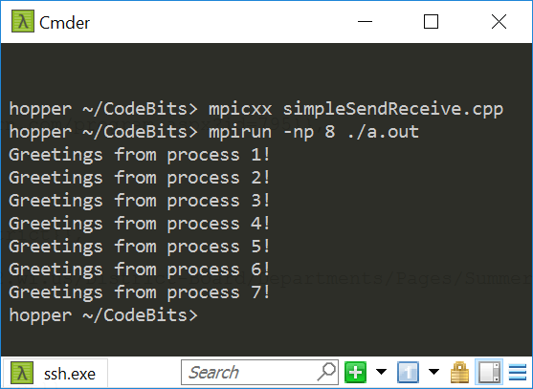
Program Output

Slide 17
The Message-Passing Programming Paradigm
The Sequential Programming Paradigm
data
memory
program
Processor/Process
Message-Passing Programming Paradigm
data
data
data
data
Distributed memory
program
program
program
program
communication network
Multiple processes
[ICHEC]→

Slide 18
Fundamental Concepts: Process/Program/Processor
A process is a software program executing a task on a processor
In other words, each process in an MPI job runs an instance of a program:
Program is written in C, C++, or Fortran. Reason: these are the languages for scientific computing, which MPI serves
The variables of each program have the same name but different locations (distributed memory) and different values
Communicate via special send & receive routines (message passing)
data
data
data
data
program
program
program
program
communication network

Slide 19
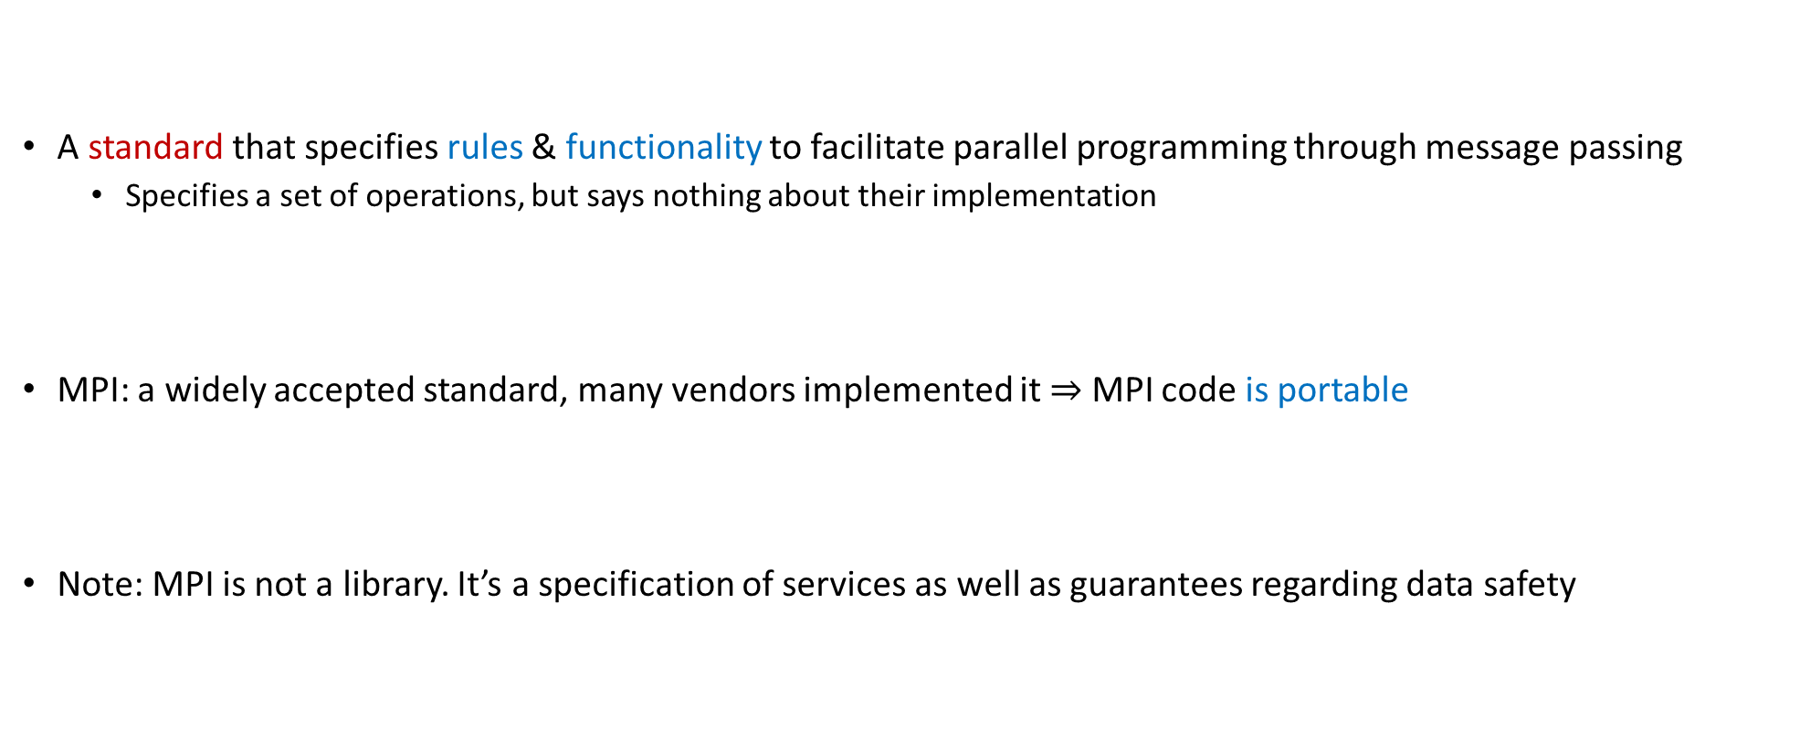
What is MPI?
A standard that specifies rules & functionality to facilitate parallel programming through message passing
Specifies a set of operations, but says nothing about their implementation
MPI: a widely accepted standard, many vendors implemented it $⇒$ MPI code is portable
Note: MPI is not a library. It’s a specification of services as well as guarantees regarding data safety

Slide 20
What is MPI?
Early implementation of MPI: MPICH (this is a library that implements [some of] the MPI specifications)
The CH comes from Chameleon, the software layer used in the original MPICH to provide portability to the existing message-passing systems
OpenMPI: another library that implements [some of] the MPI specifications
Joint effort of several groups from Los Alamos, Tennessee, Indiana University, Europe
Just as we discussed for OpenMP, MPI is a standard and different vendor provide libraries that implement a certain version of the standard and a certain set of features defined in that version of the standard

Slide 21
Where can we use MPI?
Message passing can be used wherever it is possible for processes to exchange messages:
Distributed memory systems
Networks of workstations
Even on one workstation that has many cores
An MPI job run on one workstation does not pass data over a network; it does so through the main memory

Slide 22
16 threads/ranks on one workstation (assume one socket, 16-core processor)
If 16 OpenMP threads, they will operate against the same virtual memory
If 16 MPI ranks, they do not operate against the same virtual memory
There will be 16*distinct* processes, each with its virtual memory space
Consequences:
The 16 cores running the 16 MPI ranks are going to compete for the LLC (perhaps L3?)
Compared to OpenMP, there will be less cache coherence overhead since ranks don’t operate on the same memory
Compared to OpenMP, there will be a similar level of contention for the memory bandwidth

Slide 23
Why care about MPI?
Today, MPI is what enables supercomputers to run at PFlops rates
At the node level:
A process might use GPU acceleration at the node level
A process might use OpenMP the multiple cores available on a node
Widely used in Scientific Computing, MPI has FORTRAN and C bindings

Slide 24
MPI: Pluses and Minuses
Pluses:
Access to lots of memory (across many nodes…)
Access to a lot of processors (across many nodes…)
Better scalability - No cache coherence overhead at all when two ranks run on different nodes
Large MPI jobs involve tens of thousands of processes, each running heavy weight code
Minuses:
High latency in node-to-node communication
Low bandwidth compared to what we’ve seen so far (GPU & OpenMP on a workstation)
You have to manage the process of sharing data amongst ranks
NOTE: up-to-date typical latencies & bandwidth of various systems available here
Ranges: 5-10 usec & 1-80 GB/s (BW depends heavily on size of the big-iron machine; more like 1-5 GB/s)

Slide 25
MPI vs. CUDA
When would you use GPU computing and when would you use MPI-based parallel programming?
Use GPU
If your data fits the memory constraints associated with GPU computing
You have parallelism at a fine grain so that you the SIMD paradigm applies
Example: Image processing
Use MPI-enabled parallel programming
If you have a very large problem, with a lot of data that needs to be spread out across several machines
Example: Large-scale CFD, FEA – sophisticated, multi-stage algorithms
NOTE: there are many machines on which HPC is done using both MPI and CUDA

Slide 26
MPI on Euler [Selecting MPI Distribution]
What’s available: OpenMPI, MVAPICH, MVAPICH2
OpenMPI is default on Euler
To load OpenMPI environment variables:
Typically not needed, should be done automatically for you
>> module load openmpi

Slide 27
Compiling MPI Code by Hand
Most MPI distributions provide wrapper scripts named mpicc or mpicxx
Adds in –L, -l, -I, etc. flags for MPI
Passes any options to your native compiler (gcc)
Very similar to what nvcc did for CUDA – it’s a compile driver…
>> mpicxx -o integrate_mpi integrate_mpi.cpp

Slide 28
Example, Running on Euler [Context: running the executable integrate_mpi]
### BEGINNING OF submit_mpi.sh SCRIPT ###
#!/bin/bash
#SBATCH -t 0-5:0:0
#SBATCH -o output.txt
cd $SLURM_SUBMIT_DIR
mpirun ./integrate_mpi
### END OF SCRIPT ###
euler $ sbatch –p wacc --gres=infiniband:1 -N 2 --ntasks-per-node=4 submit_mpi.sh
euler $ cat output.txt
8 32.121040666358297 in 2.171963s
euler $ sbatch –p wacc --gres=infiniband:1 -N 2 --ntasks-per-node=2 submit_mpi.sh
euler $ cat output.txt
4 32.121040666358297 in 4.600204s
euler $ sbatch –p wacc --gres=infiniband:1 -N 1 --ntasks-per-node=1
euler $ cat output.txt
1 32.121040666358297 in 15.163330s

Slide 29
Running MPI, In General
mpirun [-np #] [-machinefile file] <program> [<args>]
Number of processors. Inside SLURM, this is handled automatically.
List of hostnames to use. Inside SLURM, this is handled automatically.
Your program and its arguments
-np will be set automatically by SLURM. Do not use it.
-machinefile will be set automatically by SLURM. Do not use it.
See the mpirun manpage for more options

Slide 30
MPI with CMake
Using MPI in CMake a lot like using OpenMP
To enable MPI, the FindMPI CMake module is called using find_package
The MPI module sets a few flags which should be added to your target
find_package(MPI REQUIRED)
add_executable(problemX problemx.c)
target_include_directories(problemX ${MPI_C_INCLUDE_PATH})
target_compile_options(problemX ${MPI_C_COMPILE_FLAGS})
target_link_libraries(problemX ${MPI_C_LIBRARIES})
NOTE: Other language bindings such as MPI_CXX_* or MPI_FORTRAN_* may also be used.
30

Slide 31
Quick note…
ME759 is not about remembering how to launch (or lunch?) a job on a cluster
This is why we rely on sysadmin folks. Somebody like Colin will be there to take care of you
Instead, the focus is on understanding how things work, how you can get the code to run fast

Slide 32
Outline, Parallel Computing w/ MPI
Introduction to message passing and MPI
Point-to-Point (P2P) Communication
Collective Communication
MPI Closing Remarks

Slide 33
Parallel computing issue: Who am I? What’s my problem/task?
Parallel computing on the GPU, on multi-core chips, and multi-node (MPI) share one thing:
For each thread/rank a mechanism is in place to provide a unique ID
ID then used to figure out what that thread/rank ought to be doing
Specifically,
In CUDA you have threadIdx and blockIdx
In OpenMP you have the thread ID
In MPI you have a process rank

Slide 34
The Rank & The Communicator [As Facilitators for Data and Work Distribution]
To communicate with each other MPI processes need identifiers: rank = identifying number
Work distribution decisions are based on the rank
Helps establish which process works on which data
Just like we had thread and block indices in CUDA
myrank=0
data
myrank=1
data
myrank=2
data
myrank= (size-1)
data
program
program
program
program
communication network
[ICHEC]→

Slide 35
Message Passing: The Actors Involved
Messages are packets of data moving between different processes
Necessary information for the message passing system:
sending process + receiving process i.e., the two “ranks”
source mem.location + destination mem.location
source data type + destination data type
source data size + destination buffer size
data
program
communication network
[ICHEC]→

Slide 36
Point-to-Point (P2P) Communication
P2P: Simplest form of message passing communication
One process sends a message to another process
MPI_Send
MPI_Recv

Slide 37
MPI: Revisiting Previous Example
Example: MPI_Send / MPI_Recv
#include "mpi.h"
#include <stdio.h>
#include <string.h>
int main(int argc, char* argv[]) {
int my_rank; /* rank of process */
int p; /* number of processes */
int source; /* rank of sender */
int dest; /* rank of receiver */
int tag = 0; /* tag for messages */
char message[100]; /* storage for message */
MPI_Status status; /* return status for receive */
MPI_Init(&argc, &argv); // Start up MPI
MPI_Comm_rank(MPI_COMM_WORLD, &my_rank); // Find out process rank
MPI_Comm_size(MPI_COMM_WORLD, &p); // Find out number of processes
if (my_rank != 0) {
/* Create message */
sprintf(message, "Greetings from process %d!", my_rank);
dest = 0;
/* Use strlen+1 so that '\0' gets transmitted */
MPI_Send(message, strlen(message)+1, MPI_CHAR, dest, tag, MPI_COMM_WORLD);
}
else { /* my_rank == 0 */
for (source = 1; source < p; source++) {
MPI_Recv(message, 100, MPI_CHAR, source, tag, MPI_COMM_WORLD, &status);
printf("%s\n", message);
}
}
MPI_Finalize(); // Shut down MPI
return 0;
} /* main */
Could I use a different name here?
Notes:
Yes, you can use any variable you want, if it is of the appropriate type and can handle the data that is expected to store

Slide 38
P2P Communication, Syntax Issues: Sending a Message
buf is the starting point of the message with count elements, each described with datatype
dest is the rank of the destination process within the communicator comm
tag is an additional nonnegative integer piggyback information, additionally transferred with the message
The tag can be used to distinguish between different messages
Not very common, needed in some situations
int MPI_Send(void *buf, int count, MPI_Datatype datatype, int dest, int tag, MPI_Comm comm)
[ICHEC]→

Slide 39
P2P Communication, Syntax Issues: Receiving a Message
buf/count/datatype describe the receive buffer
Note: It better be that the memory chunk that starts at address buf can store count variables of type datatype
Receiving the message sent by process with rank source in comm
Only messages with matching tag are received
Envelope information is returned in an MPI_Status object whose address status is passed as argument
int MPI_Recv(void *buf, int count, MPI_Datatype datatype, int source, int tag, MPI_Comm comm, MPI_Status *status)
[ICHEC]→

Slide 40
The MPI_COMM_WORLD Communicator
All processes of an MPI program are members of the default communicator MPI_COMM_WORLD
MPI_COMM_WORLD is a predefined handle in mpi.h
Each process has its own rank in a given communicator:
starting with 0
ending with (size-1)
MPI_COMM_WORLD
0
1
7
2
3
5
4
6
You can define a new communicator in case you find it useful
To create a new communicator MY_COMM_WORLD
MPI_Comm_create(MPI_COMM_WORLD, new_group, &MY_COMM_WORLD);
[ICHEC]→

Slide 41
MPI_Comm_create
Synopsis
Input Parameters
comm - communicator (handle)
group - subset of the family of processes making up the comm (handle)
Output Parameter
newcomm - new communicator (handle)
NOTE: Same process has different ranks in different communicators
int MPI_Comm_create(MPI_Comm comm, MPI_Group group, MPI_Comm *newcomm);

Slide 42
Point-to-Point Communication
Communication between two processes
In pic. below: source process sends message to destination process
Communication takes place within a communicator, e.g., MY_COMM_WORLD
Processes are identified by their ranks within the communicator
Recall that the same process has different ranks in different communicators
(communicator)
MY_COMM_WORLD
0
2
message
1
5
4
3
destination
source
6
[ICHEC]→

Slide 43
The Data Type
A message contains a number of elements of some particular data type
MPI data types:
Basic data type
User-defined data types – not emphasized here
Data type handles describe the type of the data moved around
Example: message with 5 integers
2345
654
96574
-12
7676
[ICHEC]→

Slide 44
MPI-defined data types, and C counterparts
MPI Datatype | C datatype
MPI_CHAR | signed char
MPI_SHORT | signed short int
MPI_INT | signed int
MPI_LONG | signed long int
MPI_UNSIGNED_CHAR | unsigned char
MPI_UNSIGNED_SHORT | unsigned short int
MPI_UNSIGNED | unsigned int
MPI_UNSIGNED_LONG | unsigned long int
MPI_FLOAT | float
MPI_DOUBLE | double
MPI_LONG_DOUBLE | long double
MPI_BYTE
MPI_PACKED
count=5
datatype=MPI_INT
int arr[5]
Example:
2345
654
96574
-12
7676
[ICHEC]→

Slide 45
Message Order Preservation
Rule for messages on the same connection; i.e., same communicator, source, and destination rank:
Messages do not overtake each other
If both receives match both messages, then the order is preserved
0
2
1
5
4
3
6
[ICHEC]→

Slide 46
The Mechanics of P2P Communication: Wildcarding
Receiver can wildcard
To receive from any source – source = MPI_ANY_SOURCE
To receive from any tag – tag = MPI_ANY_TAG
Actual source and tag returned in receiver’s status argument
One more instance where the status argument comes into play
[ICHEC]→

Slide 47
MPI_Recv: The Need for an MPI_Status Argument
The MPI_Status object updated by the MPI_Recv call settles a series of questions:
The receive call does not specify the size of an incoming message, but only an upper bound on the receive buffer
The actual size only known to the sender (think about it)
The source or tag of a received message may not be known if wildcard values were used in a receive operation

Slide 48
The Mechanics of P2P Communication: Communication Envelope
From: source (rank)
tag
Envelope information is returned from MPI_RECV via the status pointer
status->MPI_SOURCE status->MPI_TAG count via MPI_Get_count()
To: destination rank
item-1
item-2
item-3 count
item-4 elements
...
item-n
int MPI_Get_count(MPI_Status *status, MPI_Datatype datatype, int *count);
INPUT: status and datatype. OUTUPT: count
[ICHEC]→

Slide 49
The Mechanics of P2P Communication: Some Rules of Engagement
For a communication to succeed:
Sender must specify a valid destination rank
Receiver must specify a valid source rank
The communicator must be the same
Tags must match
Message data types must match
Receiver’s buffer must be large enough
[ICHEC]→

Slide 50
MPI_Send & MPI_Recv: The Eager and Rendezvous Flavors
If you send small messages, the content of the buffer is sent to the receiving partner immediately
Operation happens in “eager mode”
If you send a large amount of data, the sender function waits for the receiver to post a receive before sending the actual data of the message
Operation happens in “rendezvous mode”
Why this eager-rendezvous dichotomy?
Because of the size of the data and the desire to have a safe implementation
If you send a small amount of data, the MPI implementation can afford to buffer the content and subsequently carry out the transaction later on, when the receiving process asks for that data
Doesn’t fly if you attempt to move around a big chunk of data

Slide 51
MPI_Send & MPI_Recv: Eager OR Rendezvous?
Each implementation of MPI has a default value (which might change at run time) beyond which a larger MPI_Send stops acting in “eager mode”
The MPI standard doesn’t provide specifics
You don’t know how large is too large…
Consult your implementation’s documentation or measure it yourself
Does it matter if it’s Eager or Rendezvous?
Yes, sometimes the code can hang – example to come
Remark: the Eager vs. Rendezvous modes → they exclusively concern the MPI_Send and MPI_Recv send/receive flavors.
There are other ways to send data, beyond plain vanilla MPI_Send. More to come

Slide 52
Send/Receives: Blocking vs. Non-blocking [important slide]
MPI send/receive operations can be classified based on whether they are blocking or non-blocking
Blocking send: upon return from a send operation, you can modify the content of the buffer in which you stored data to be sent since the data has been sent
Non-blocking: the send call returns immediately; there is no guarantee that the data has actually been transmitted upon return from send call
More on this later; flavor appeared because of some issues associated w/ the blocking aspect

Slide 53
Point-to-Point Communication: Problems w/ the Blocking Plain Send
Two problems with plain vanilla blocking send/receive:
When sending, there is no overlap of compute & data movement (I need to wait until the send completed, which can be a while)
If not done properly, the processes executing the MPI code can hang
Note that there are other flavors of send/receive, see next slide

Slide 54
Blocking Type: Communication Modes
Send communication modes:
Synchronous send → MPI_SSEND
Buffered [asynchronous] send → MPI_BSEND
Standard send → MPI_SEND
Ready send → MPI_RSEND
Receiving all modes → MPI_RECV
[ICHEC]→

Slide 55
Point-to-Point Communication: The MPI_Bsend flavor
Another blocking P2P communication alternative that reduces the overhead associated with data transmission
Realized through MPI_Bsend (buffered)
Your data is quickly moved to a “staging buffer” and then the call returns and renders the control back to you
NOTE: *you* need to provide this additional buffer that stages the transfer. *You* should also decide how big it is
Relevant question: how large should *that* staging buffer be?
If you keep posting buffered sends that are not matched by corresponding “MPI_Recv” operations, you are going to overflow this staging buffer sooner or later
Notes:
DN: What is this slide???

Slide 56
More on the Buffered Send [1/2]
Relies on the existence of a buffer, which is set up through a call
int MPI_Buffer_attach(void* buffer, int size);
MPI_Bsend: a local operation. Does not depend on the occurrence of a matching receive in order to complete
If a bsend operation is started and no matching receive is posted, the outgoing message is buffered to allow the send call to complete
Return from an MPI_Bsend does not guarantee the message was sent
Message remains in the buffer until a matching receive is posted

Slide 57
More on the Buffered Send [2/2]
Make sure you have enough buffer space available. An error occurs if the message must be buffered and there is there is not enough buffer space
The amount of buffer space needed to be safe depends on the expected peak of pending messages. The sum of the sizes of all of the pending messages at that point plus (MPI_BSEND_OVERHEAD*number_of_messages) should be sufficient
MPI_Bsend lowers bandwidth since it requires an extra memory-to-memory copy of the outgoing data
The MPI_Buffer_attach subroutine provides MPI a buffer in the user's memory. This buffer is used only by messages sent in buffered mode, and only one buffer is attached to a process at any time

Slide 58
Further comments on the four flavors for sending data in MPI
Synchronous with MPI_Ssend
In synchronous mode, a send will not complete until a matching receive is posted.
The sender has to wait for a receive to be posted
No buffering of data
Used for ensuring the code is healthy and doesn’t rely on buffering
Buffered with MPI_Bsend
Send completes once message has been buffered internally by MPI
Buffering incurs an extra memory copy
Does not require a matching receive to be posted
May cause buffer overflow if many Bsend posted and no matching receives have been posted yet
[A. Snavely]→

Slide 59
Four flavors for sending data in MPI
Standard with MPI_Send
Up to the MPI implementation to decide whether to do rendezvous or eager, for performance reasons
NOTE: If it does rendezvous, in fact the behavior is that of MPI_Ssend
Very commonly used
Ready with MPI_Rsend
Will work correctly only if the matching receive has been posted
Can be used to avoid handshake overhead when is known for sure that the receive has been posted
Rarely used, can cause major problems
Undefined behavior if a matching receive has not been posted
[A. Snavely]→

Slide 60
Cheat Sheet, Blocking Options
Sender modes | Definition | Notes
Synchronous send MPI_SSEND | Only completes when the receive has started
Buffered send MPI_BSEND | Always completes (unless an error occurs), irrespective of receiver | needs application-defined buffer to be declared with MPI_BUFFER_ATTACH
Classic MPI_SEND | Standard send | Rendezvous or eager mode. Decided at run time
Ready send MPI_RSEND | Started right away. Will do the job only if the matching receive has already been posted! | Blindly do a send. Avoid, might cause unforeseen problems…
Receive MPI_RECV | Completes when a the message (data) has arrived
[ICHEC]→

Slide 61
Side-trip: TCP/IP vs. UDP Analogy
There is a parallel between how MPI_Send and MPI_Rsend different, on the one hand, and how TCP/IP and UDP are different, on the other hand
TCP/IP: you send something out
You do not declare victory until the receiver pings you that all packets have been received and it’s all good
Very safe. You pay a premium for this
UDP: you send something out
You declare victory right away
Not safe, you don’t know if the receiver actually got your packet[s]. It’s fast
UDP and TCP/IP otherwise similar – just two APIs for sending information out over a network
Note: UDP used in online gaming, for instance
Notes:
https://www.howtogeek.com/190014/htg-explains-what-is-the-difference-between-tcp-and-udp/
https://support.holmsecurity.com/hc/en-us/articles/212963869-What-is-the-difference-between-TCP-and-UDP-

Slide 62
P2P Communication: Deadlocking
Deadlock situations: due to a certain sequence of commands the MPI execution hangs
Process 0
Process 1
...
MPI_Ssend()
MPI_Recv()
...
...
MPI_Buffer_attach()
MPI_Bsend()
MPI_Recv()
...
...
MPI_Buffer_attach()
MPI_Bsend()
MPI_Recv()
...
...
MPI_Ssend()
MPI_Recv()
...
...
MPI_Buffer_attach()
MPI_Bsend()
MPI_Recv()
...
...
MPI_Ssend()
MPI_Recv()
...
Deadlock
No
Deadlock
No
Deadlock
[A. Snavely]→

Slide 63
Deadlocking, Another Example
MPI_Send can respond in eager or rendezvous mode
Example, on a certain machine running MPICH v1.2.1:
Process 0
Deadlock
Process 1
...
MPI_Send()
MPI_Recv()
...
...
MPI_Send()
MPI_Recv()
...
Data size > 127999 bytes
Data size < 128000 bytes
No
Deadlock
[A. Snavely]→

Slide 64
Avoiding Deadlocking
Easy way to eliminate deadlock is to pair MPI_Ssend and MPI_Recv operations the right way:
Process 0
Process 1
...
MPI_Ssend()
MPI_Recv()
...
...
MPI_Recv()
MPI_Ssend()
...
No
Deadlock
Conclusion: understand how the implementation works and what its pitfalls/limitations are
[A. Snavely]→

Slide 65
Example
Always succeeds, even if no buffering is done
if(rank==0)
{
MPI_Send(...); // send to 1
MPI_Recv(...); // recv from 1
}
else if(rank==1)
{
MPI_Recv(...); // recv from 0
MPI_Send(...); // send to 0
}

Slide 66
Example
Will always deadlock, no matter the buffering mode
if(rank==0)
{
MPI_Recv(...); // recv from 1
MPI_Send(...); // send to 1
}
else if(rank==1)
{
MPI_Recv(...); // recv from 0
MPI_Send(...); // send to 0
}

Slide 67
Timing an MPI Job
int main()
{
double starttime, endtime;
starttime = MPI_Wtime();
// .... stuff to be timed ...
endtime = MPI_Wtime();
printf("That took %f seconds\n", endtime - starttime);
return 0;
}
Returns time in seconds since an arbitrary time in the past.
Resolution is typically 1E-3 seconds (see MPI_Wtick)
Time of different processes might actually be synchronized, controlled by the variable MPI_WTIME_IS_GLOBAL

Slide 68

Determine the eager/rendezvous threshold [useful for HW as well]
#include "mpi.h"
#include <stdio.h>
#include <stdlib.h>
#define LIMIT 500000
#define NLOOPS 1000
int main(int argc, char **argv) {
int rank, npes, bsize, i;
int source = 0, dest = 1, tag = 100;
double start, end;
char buf[LIMIT];
MPI_Status status;
MPI_Init(&argc, &argv);
MPI_Comm_rank(MPI_COMM_WORLD, &rank);
MPI_Comm_size(MPI_COMM_WORLD, &npes);
if (npes != 2)
MPI_Abort(MPI_COMM_WORLD, 1);
if (rank == 0)
bsize = (argc == 2) ? atoi(argv[1]) : 0;
MPI_Bcast(&bsize, 1, MPI_INT, 0, MPI_COMM_WORLD);
if (bsize <= 0 || bsize > LIMIT) {
MPI_Finalize(); // drop out, if size is not OK
return 0;
}
if (rank == source) {
for (i = 0; i < bsize; i++)
buf[i] = 'x'; // fill up the buffer with data to be sent over
start = MPI_Wtime();
for (i = 0; i < NLOOPS; i++)
MPI_Send(buf, bsize, MPI_BYTE, dest, tag, MPI_COMM_WORLD);
end = MPI_Wtime();
printf("Send: %d\t%f\n", bsize, (end - start) / NLOOPS);
start = MPI_Wtime();
for (i = 0; i < NLOOPS; i++)
MPI_Ssend(buf, bsize, MPI_BYTE, dest, tag, MPI_COMM_WORLD);
end = MPI_Wtime();
printf("Ssend: %d\t%f\n\n", bsize, (end - start) / NLOOPS);
}
if (rank == dest) {
for (i = 0; i < NLOOPS; i++)
MPI_Recv(buf, bsize, MPI_BYTE, source, tag, MPI_COMM_WORLD, &status);
for (i = 0; i < NLOOPS; i++)
MPI_Recv(buf, bsize, MPI_BYTE, source, tag, MPI_COMM_WORLD, &status);
}
MPI_Finalize();
return 0;
}
[Radu Serban]$→$

Slide 69
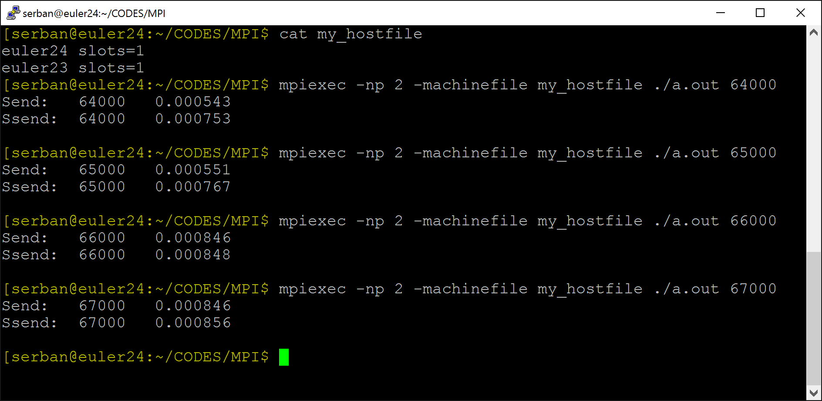
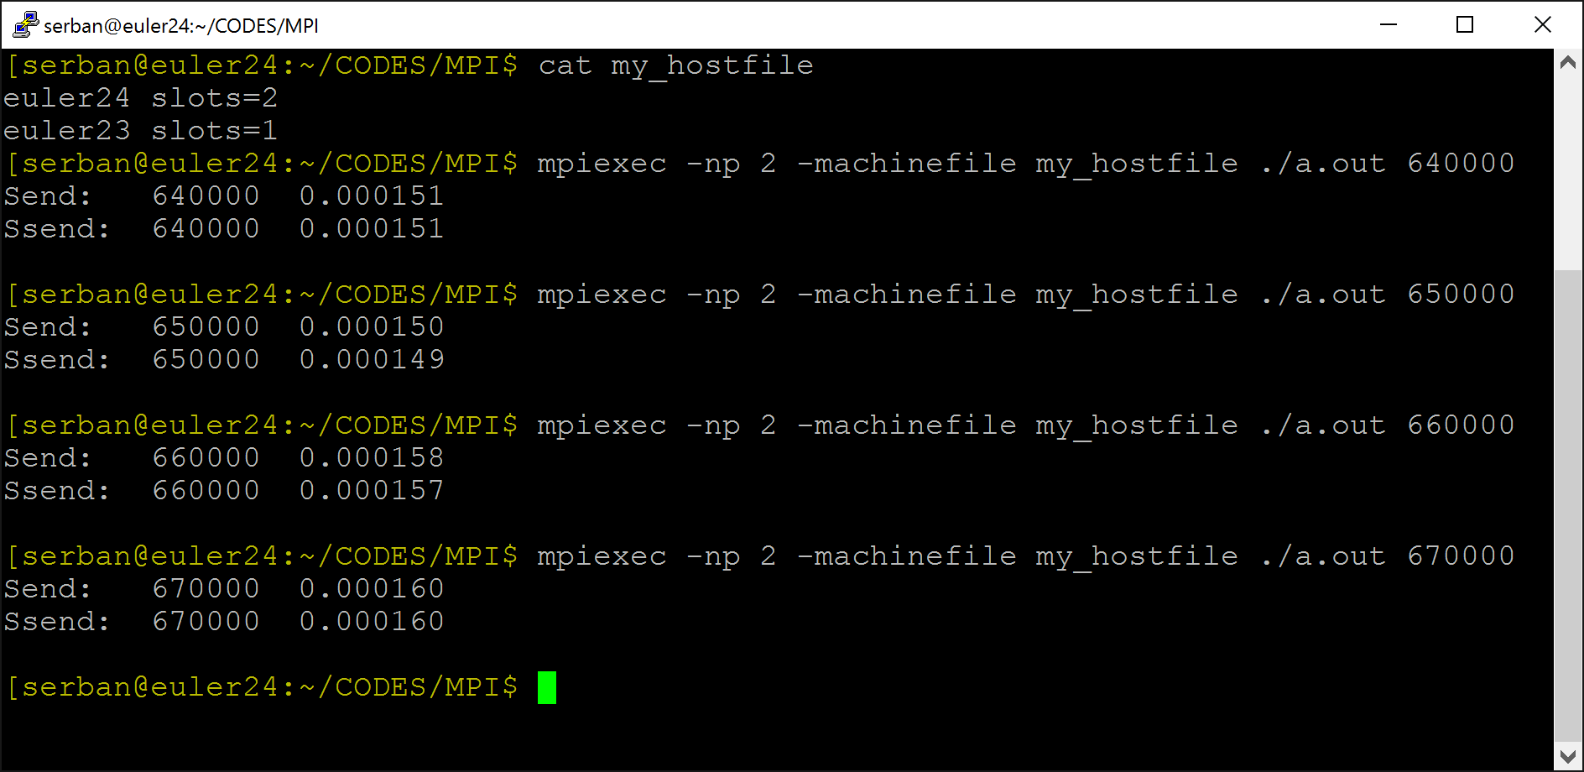
Results
Two processes on two different nodes
Threshold between 64 KB and 65 KB
Two processes on the same node
No difference between Send and Ssend (regardless of message size)
[Radu Serban]$→$

Slide 70
MPI_Probe and MPI_Iprobe [two-slide detour]
The MPI_PROBE and MPI_IPROBE operations allow incoming messages to be checked for, without actually receiving them
The user can then decide how to receive them, based on the information returned by the probe (basically, the information returned by status)
In particular, the user may allocate memory for the receive buffer, according to the length of the probed message

Slide 71
Probe to Receive
Probe yields incoming size
Blocking probing, wait till match
int MPI_Probe(int source, int tag, MPI_Comm comm, MPI_Status *status);
Non-blocking probing, flag set to true if ready
int MPI_Iprobe(int source, int tag, MPI_Comm comm, int *flag, MPI_Status *status);
[Alexander]→

Slide 72
Concluding Remarks: Blocking P2P communication
Standard send (MPI_SEND)
minimal transfer time if it happens in eager mode
blocks in rendezvous, switches to synchronous mode
Synchronous send (MPI_SSEND)
risk of deadlock
risk of serialization
risk of waiting → idle time
high latency / best bandwidth
Buffered send (MPI_BSEND)
low latency / low bandwidth
Ready send (MPI_RSEND)
never use, unless 100% sure that Recv is already called in the current version and all future versions of your code
[ICHEC]→

Slide 73
Non-blocking, P2P Communication

Slide 74
Non-Blocking P2P Communication: Motivation
How non-blocking communication comes into play - there’s three stages to it:
Initiate non-blocking communication
Returns Immediately
Routine name starting with MPI_I…
Do some other useful work
“latency hiding”
Wait for non-blocking communication to complete
Bottom line: Like with CUDA kernel launch, you can overlap communication with execution

Slide 75
P2P Communication: The looking danger w/ non-blocking MPI_Isend
The “I” flavor switches you to an asynchronous operation mode. No free lunch though
If non-blocking, then data “lives” in your buffer – think twice before changing its content since not clear when transaction has completed and it becomes safe to mess with the content of the buffer
There are mechanisms to check for MPI_Isend completion (to give you a green light to change its content)
However, they add overhead :-(
Notes:
DN: What is this slide???

Slide 76
Non-blocking Send/Receive
There was no such thing in the good old MPI_Send (and the other blocking flavors)
Syntax
int MPI_Isend(void *buf, int count, MPI_Datatype datatype, int dest, int tag, MPI_Comm comm, MPI_Request *req);
buf - [in] initial address of send buffer (choice)
count - [in] number of elements in send buffer (integer)
datatype - [in] datatype of each send buffer element (handle)
dest - [in] rank of destination (integer)
tag - [in] message tag (integer)
comm - [in] communicator (handle)
req - [out] communication request (handle)
int MPI_Irecv(void *buf, int count, MPI_Datatype datatype, int source, int tag, MPI_Comm comm, MPI_Request *req);
For the good old MPI_Recv, this used to be MPI_Status

Slide 77
Non-Blocking Send/Receive Some Tools of the Trade
Call returns immediately. Therefore, user must worry whether …
Data to be sent is out of the send buffer before trampling over the buffer
Data to be received has arrived before using the content of the buffer
Tools that come in handy:
For sends and receives in flight
MPI_Wait – blocking: you go synchronous
MPI_Test – non-blocking: returns quickly with status information
These helper tools: all use the MPI_Request object – it is like the “fingerprint” of a certain MPI operation
You use this fingerprint as input when you want to find information about the status of the MPI operation

Slide 78
The Screenplay: Non-Blocking P2P Communication
Non-blocking send
MPI_Isend(...)
do some other work here
MPI_Wait(...)
0
Non-blocking receive
MPI_Irecv(...)
do some other work here
MPI_Wait(...)
1
= waiting until operation locally completed
[ICHEC]→

Slide 79
Waiting for Isend/Ireceive to Complete
Waiting on a single send
int MPI_Wait(MPI_Request *request, MPI_Status *status);
Waiting on multiple sends (get status of all)
Till all complete, as a barrier
int MPI_Waitall(int count, MPI_Request *requests, MPI_Status *statuses);
Till at least one completes
int MPI_Waitany(int count, MPI_Request *requests, int *index, MPI_Status *status);
Helps manage progressive completions
int MPI_Waitsome(int incount, MPI_Request *requests, int *outcount, int *indices, MPI_Status *statuses);
[IN]
[OUT]
[Alexander]→

Slide 80
MPI_Test
When completed, flag is true
int MPI_Test(MPI_Request *request, int *flag, MPI_Status *status);
Similar in meaning to MPI_Waitsome, except nonblocking
int MPI_Testsome(int incount, MPI_Request *requests, int *outcount, int *indices, MPI_Status *statuses);
int MPI_Testall(int count, MPI_Request *requests, int *flag, MPI_Status *statuses);
int MPI_Testany(int count, MPI_Request *requests, int *index, int *flag, MPI_Status *status);
[IN]
[OUT]
[OUT]
[Alexander]→

Slide 81
MPI P2P Communication: Take Away Points
Two types of communication:
Blocking:
Safe to change content of buffer holding on to data in the MPI send call
Non-blocking:
Be careful with the data in the buffer, since you might step on/use it too soon
MPI provides four modes for these two types
standard, synchronous, buffered, ready
Beware of possible deadlock

Slide 82
Quiz
How is MPI_Issend supposed to work?
How is MPI_Ibsend supposed to work?
Starts a nonblocking buffered send
Notes:
MPI_Issend:
Starts a nonblocking synchronous send
No eager mode for this guy
MPI_Ibsend:
- Starts a nonblocking buffered send

